Slide 1
The civil rights movement in the USA
From 1954 to 1968

Slide 2
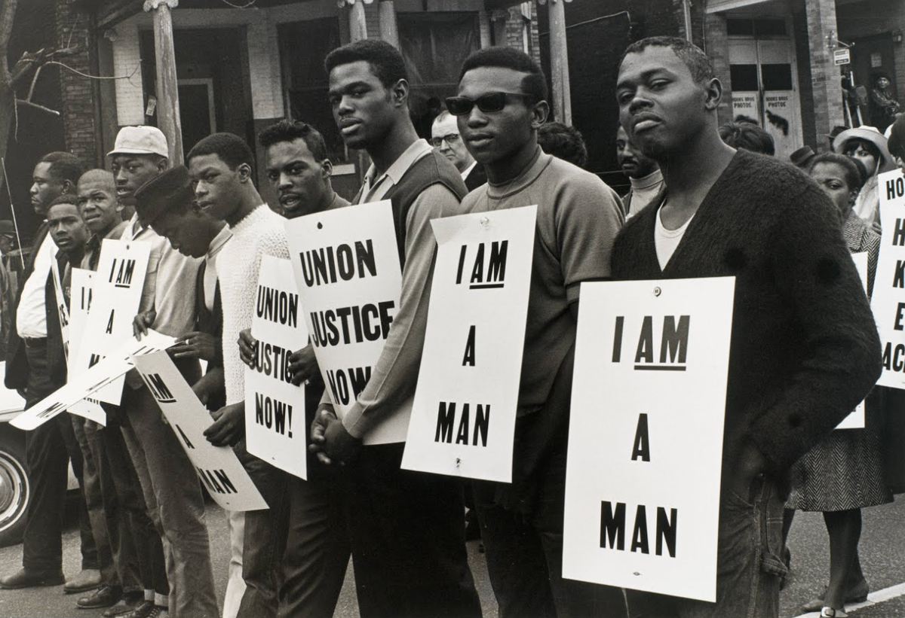
Why create this movement ?
Movement to fight against racism
Fight for equality beetween black and white men

Slide 3
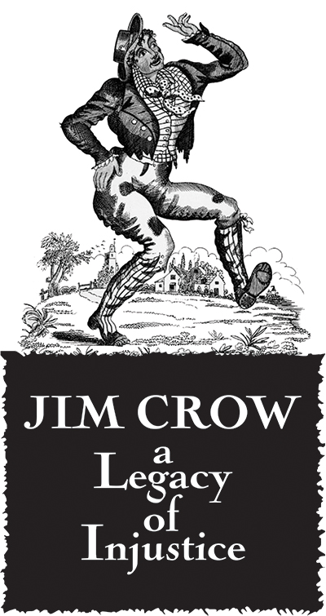
And espeficially
Fight against Jim Crow laws

Slide 4
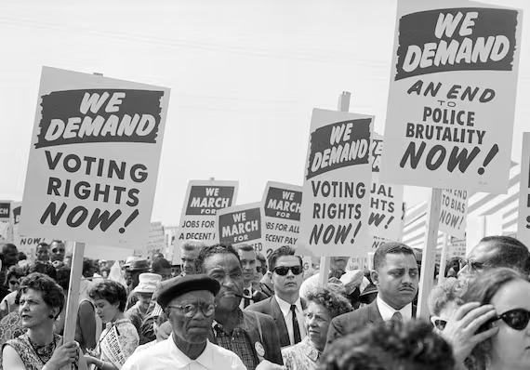
How did they manifest ?
Non-violence, civil disobedience

Slide 5
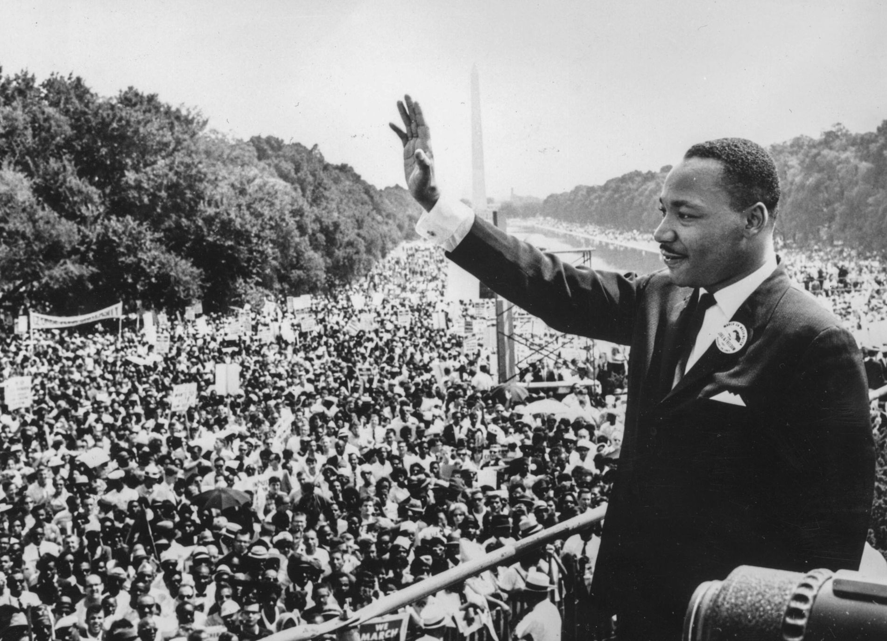
Martin Luther King
Promote equality : economic, social.
Fraternity : judge people about character and not skin colour

Slide 6
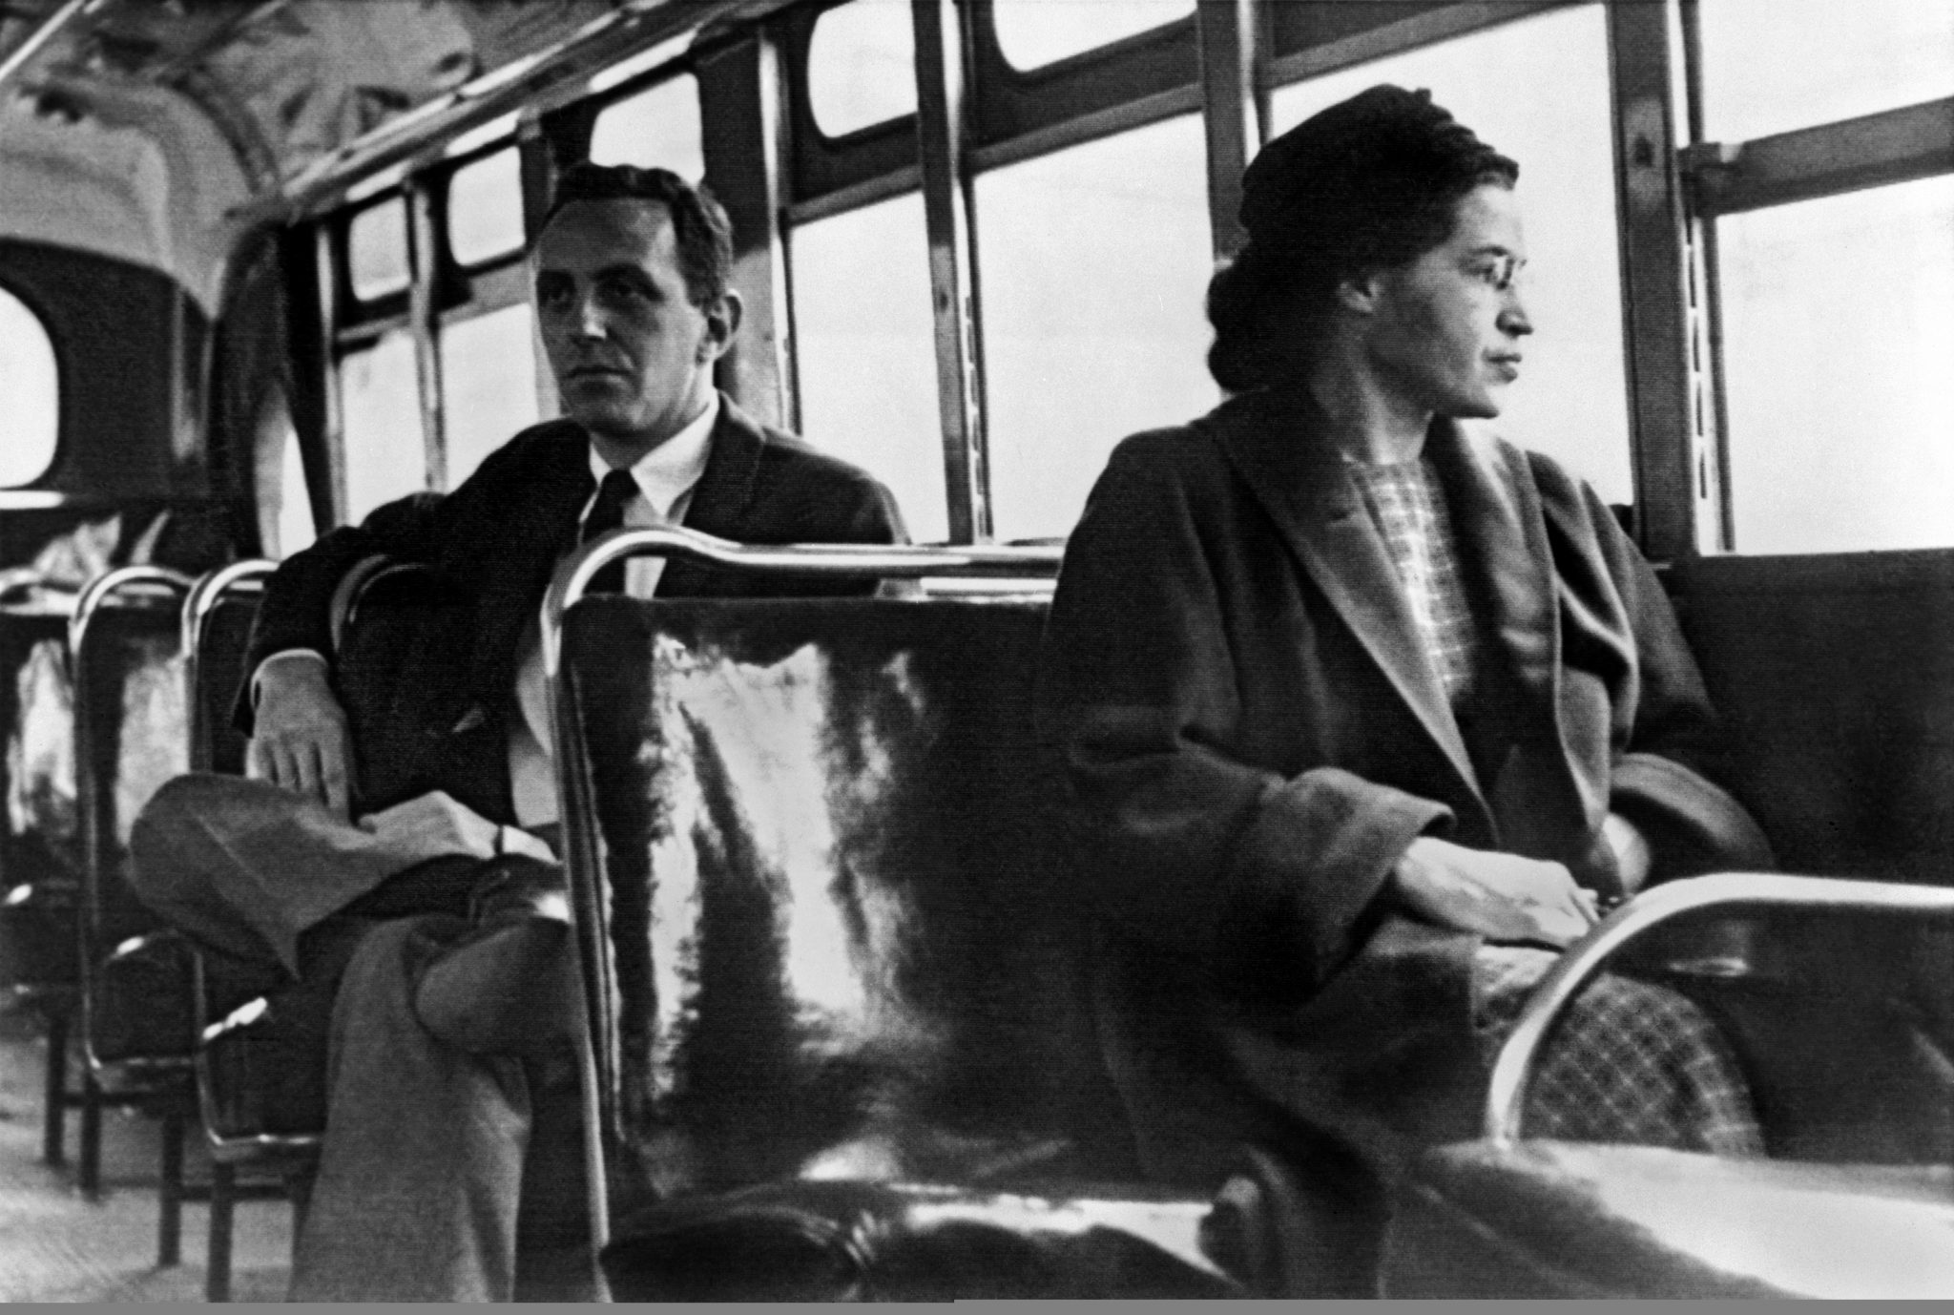
Rosa Parks
Boycott Montgomery Bus

Slide 7
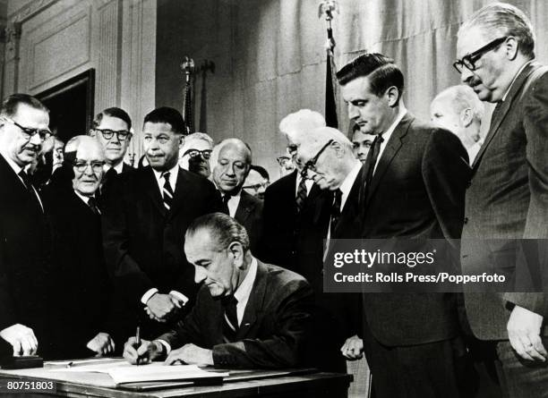
Measures
Brown v.Board Education(1954)
Civil Rights Act(1964)
Voting Right Act(1965)

